Slide 1















Financial
Analysis
Presented By :
Shiva Kashyap

Slide 2







Business Problems Addressed
Revenue & interest trend analysis
Card performance comparison
Customer segmentation insights

Slide 3
Why Analysis Matters in Credit Card Financial Insights
Credit card analysis helps identify spending patterns, revenue drivers, and high-interest segments across customers.
It enables data-driven decisions by tracking transactions, income groups, and customer behavior trends.
Overall, analysis transforms raw credit card data into actionable insights for financial performance and risk control.

Slide 4




Components of Credit Card Analytics
Credit card analytics focuses on transactions, customer behavior, and spending categories.
It includes revenue, interest, and expense analysis across card types and customer segments.
These components together help drive insights for profitability, risk management, and strategic decision-making.

Slide 5





The 50/30/20 Spending Framework in Credit Card Transaction & Customer Analytics
This framework helps analyze customer spending priorities, discretionary usage, and savings behavior using transaction and customer dashboards.

Slide 6

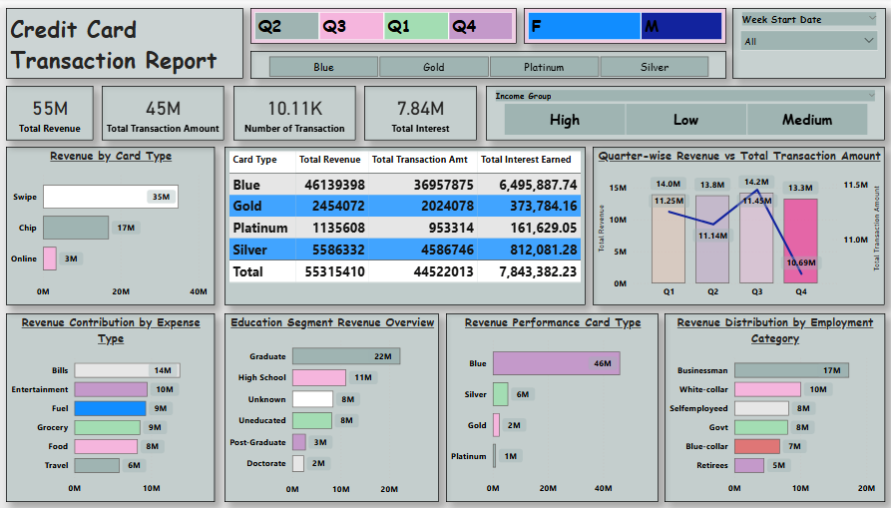

Dashboard: 1
Credit Card Transaction Performance Dashboard

Slide 7
Dashboard: 1
Credit Card Transaction Performance Dashboard (Insights)
The dashboard reports ₹55M Total Revenue generated from ₹45M Total Transaction Amount, reflecting strong overall card usage.
A total of 10.11K transactions were recorded, indicating healthy transaction volume across customers.
₹7.84M Total Interest earned highlights significant revenue contribution from revolving credit balances.
By card type, Blue cards dominate with ₹46.1M revenue, followed by Silver (₹5.9M), Gold (₹2.45M), and Platinum (₹1.13M).
Swipe transactions contribute the highest revenue at ₹35M, compared to Chip (₹17M) and Online (₹3M) payments.
Quarterly analysis shows peak revenue in Q3 (₹14.2M), while Q4 dips to ₹11.5M, indicating seasonal variation.
Expense-wise, Bills (₹14M) and Entertainment (₹10M) are the top spending categories, driving a major share of total revenue.

Slide 8

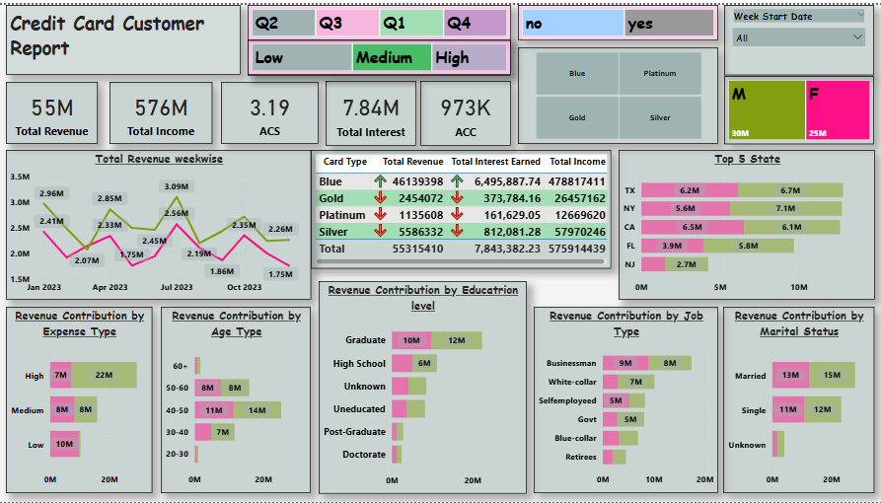
Dashboard:2 Credit Card Customer Performance Dashboard

Slide 9
Dashboard:2 Credit Card Customer Performance Dashboard(Insight)
The dashboard reports ₹55M Total Revenue generated from a strong ₹576M Total Customer Income, indicating high earning potential across customers.
Total Interest Earned stands at ₹7.84M, showing a significant contribution from credit usage and revolving balances.
The Average Customer Spend (ACS) is 3.19, reflecting consistent transaction behavior across customer segments.
With 973K active credit card customers (ACC), the portfolio demonstrates a large and diversified customer base.
Gender-wise revenue distribution shows Male customers contributing ₹30M and Female customers ₹25M, indicating balanced usage.
State-level analysis highlights TX, CA, NY, FL, and NJ as top-performing regions, with TX contributing ~₹12.9M combined value.
Education, job type, age group, and marital status charts reveal that graduates, white-collar/business professionals, and mid-age groups contribute the highest share of revenue.

Slide 10


Conclusion
By combining insights from both the Credit Card Transaction and Customer dashboards, it is clear that strong revenue performance (₹55M total revenue) is driven by high transaction volume (10.11K transactions), significant interest income (₹7.84M), and a large, diversified customer base (973K customers). Blue and Silver card types, swipe transactions, and essential spending categories such as bills and entertainment contribute the most to revenue. Customer analytics further show that higher-income, graduate, and working professional segments across key states are the primary value drivers. Overall, integrating transaction trends with customer behavior enables data-driven strategies for revenue growth, customer segmentation, and risk management.

Slide 11
Thank You
githublink : https://github.com/98shiva
Presented By :
Shiva Kashyap

